Slide 1
STUDENT MANAGEMENT SYSTEM
Amandeep Kaur(199629220)

Slide 2
Summary of project
Scope of project
Student potral is a website where student can regiter themselves and can login themselves in the portal.
PHP
PHP is a server scripting language and a powerful tool for making dynamic and interactive web pages.
PHP is a widely-used, free and efficient alternative to competitors.
Cypress
Cypress is a next generation front end testing tool built for the modern web.
This enables you to write faster, easier and more reliable tests:
▪︎ End to End tests
▪︎ Integration tests
▪︎ Unit tests

Slide 3
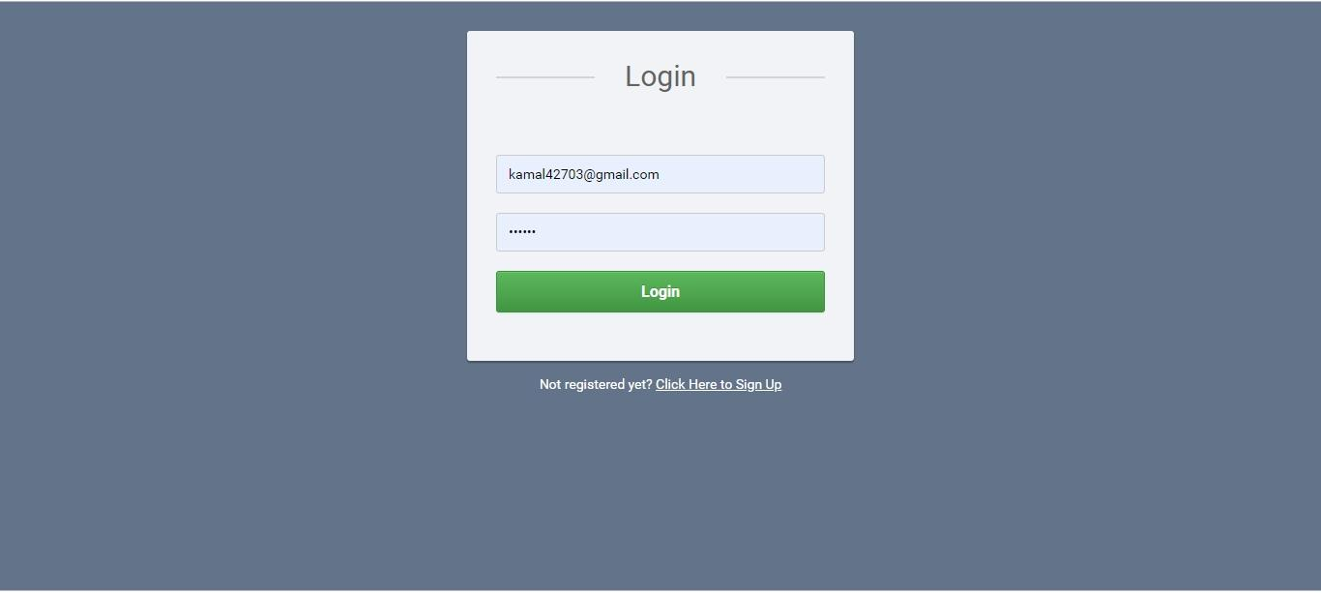
Project Screenshots 1. Login Page

Slide 4
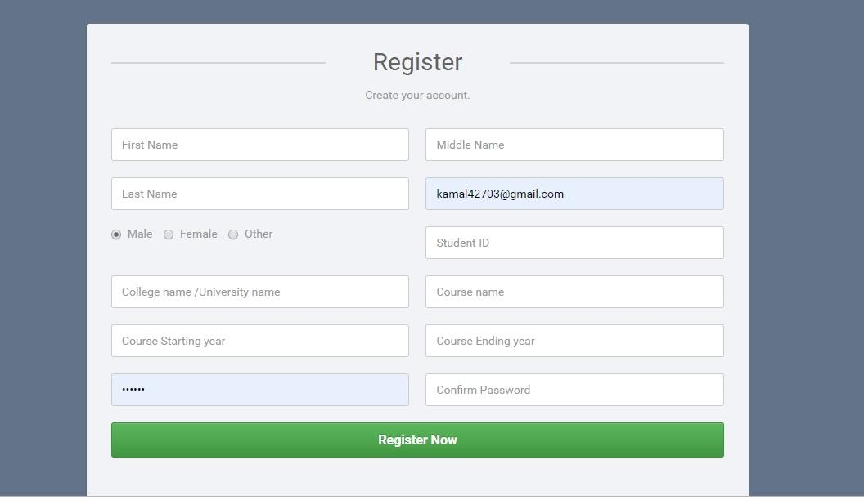
2. Registration

Slide 5
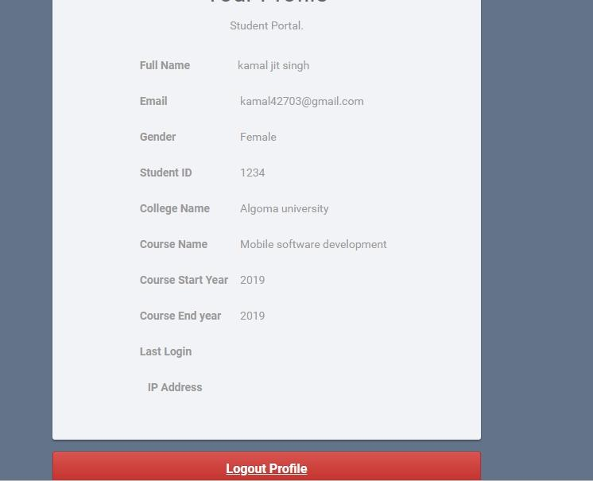
3. Logged in

Slide 6
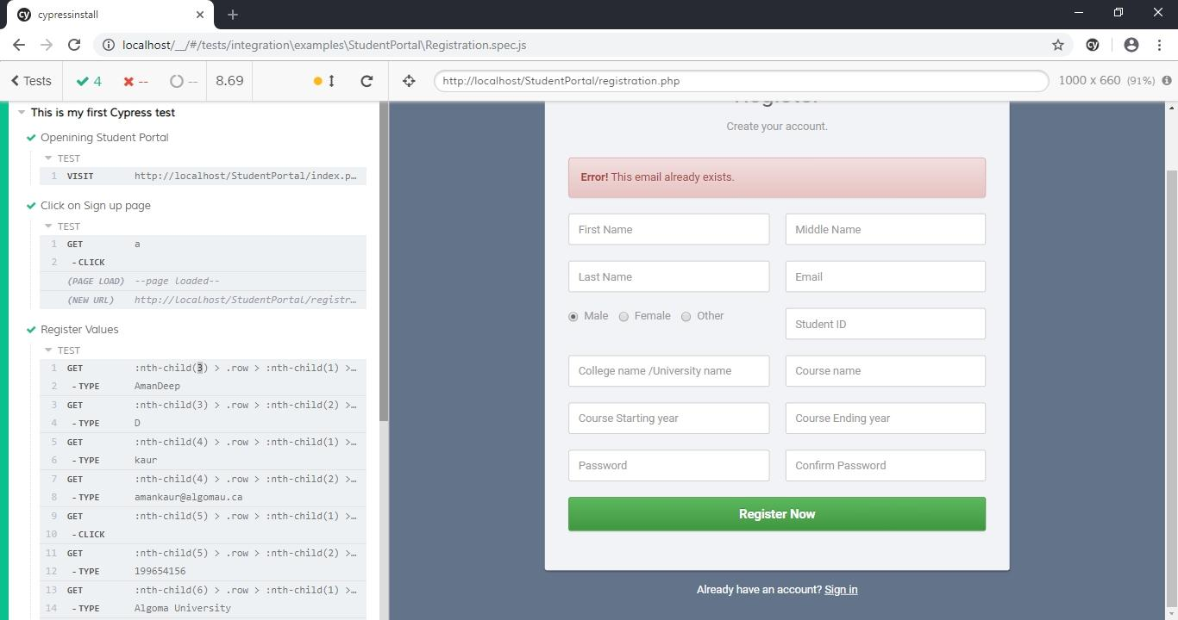
4. Test Cases • Registration

Slide 7
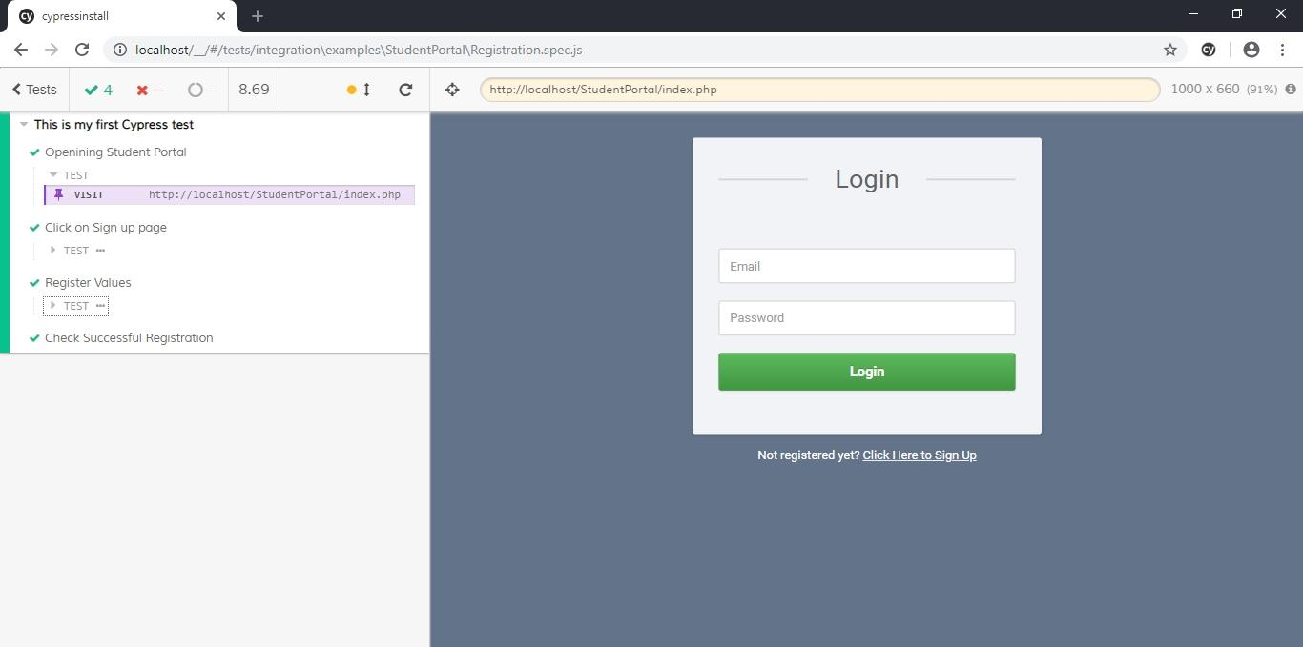
Sign Up - Passed

Slide 8
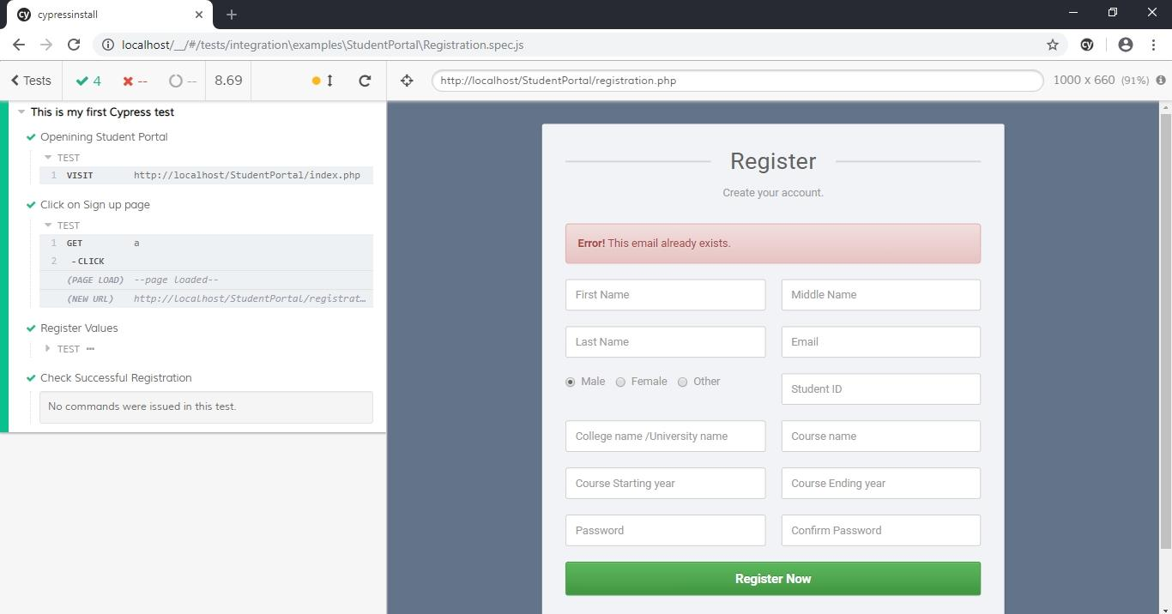
Put same credentials - Failed

Slide 9
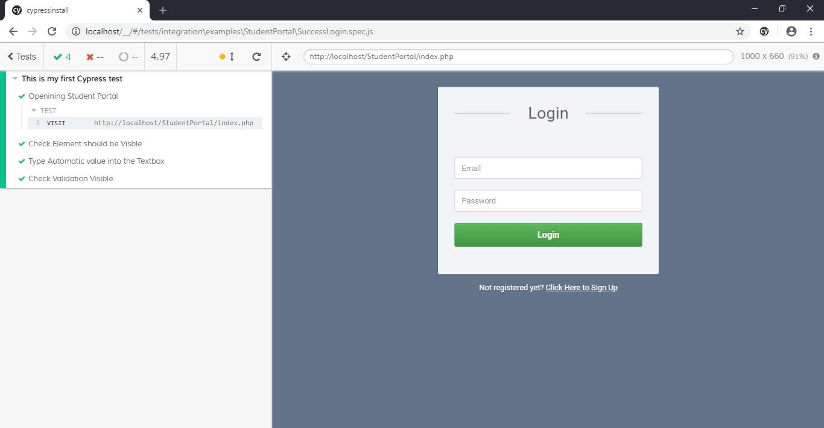
Check login validations

Slide 10
Pipeline
A job is not created because Jenkins server is not available.

